Slide 1
Software Product Management ASSIGNMENT 2 Chouk Connect System (CCS)
Group 5
AMIT NAIK (2022MT93215)
ANAND PRAKASH DUBEY (2022MT93359)
ANANT PATNI (2022MT93238)
ANDRADE PRAKASH PETER MARGARET (2022MT93366)
ANGSHUMAN PAL (2022MT93165)

Slide 2
Team Intro
AMIT NAIK (2022MT93215)
ANAND PRAKASH DUBEY (2022MT93359)
ANANT PATNI (2022MT93238)
ANDRADE PRAKASH PETER MARGARET (2022MT93366)
ANGSHUMAN PAL (2022MT93165)

Slide 3
Group Discussion link
Assignment 2 - Discussion
http://taxila-aws.bits-pilani.ac.in/mod/forum/discuss.php?d=58810
Assignment 1 - Discussion
http://taxila-aws.bits-pilani.ac.in/mod/forum/discuss.php?d=56909

Slide 4
About (Product Idea)
“Chouk Connect” is an application which provide a complete end to end solution for both parties (labors and employer).
It is your one-stop destination for expert local services. Get dozens of trusted professionals near you to take care of all your problem
It is a service provider business that connects service seekers with service providers

Slide 5
Target Customer
This product caters to a wide range of users, from those with little knowledge of the task at hand to professionals seeking additional support. Its scalability makes it accessible to users across the spectrum of expertise.
Individuals who lack the time to clean on their own
Individuals who prefer not to perform cleaning tasks themselves
Individuals who are unable to clean due to various reasons
Individuals with health conditions requiring specialized cleaning services
Businesses seeking cleaning services to maintain a positive image
Businesses seeking cleaning services to meet regulatory requirements

Slide 6
Value Proposition
Final product will create an app-based and web-based system designed to connect customer and professional staff. Create job opportunity for low end professional or uneducated people
Value Proposition:
This app is very user friendly and available in main languages so it can cover large number of audiences.
User must register themselves as either or the category (Skilled Worker or Employer)
If user is skilled worked, then they must provide their skills and work area preferences and hourly rate and they must update their profile and show case themselves and availability time.
If user is employer, then they must put bidding details and hourly rate and select available skilled workers.
Both users can see available skilled work and available work in given area

Slide 7
Story Map
User Activities
User Account
Orders & Payments
Tracking & Feedback
Customer Support & User Profile
Release 1 Minimum Viable Product
Registration
(Customers & Chefs)
Menu, Search, Cart
Track Labors
Update Profile
Login/Password
Payment
UPI, Card, COD
Feedback
Support: e-mail, phone, chat
Release 2
User Booking Services
Labor Status
No. of Orders Customer done
AI Bots for Support
Confirm Date/Time
Addon Page/Additional Service page
Provide work done Images by labor
Release 3 Additional Features
Filter options as per rating
Rewards points
Real time tracking
Labor’s Success stories

Slide 8
MVP features
The Minimum Viable Product (MVP) features of the CCS application are:
A user-friendly interface that allows users to book their requirements and get quick response from provide in a few simple clicks
Integration with Google Maps or other mapping services to locate the near by provider
Cashless payment system via credit/debit card or digital wallet
In-app rating and review system for both ends (customers and providers)
Push notifications for any requirements update or provider information updates
Provider's background checks for safety and quality services

Slide 9
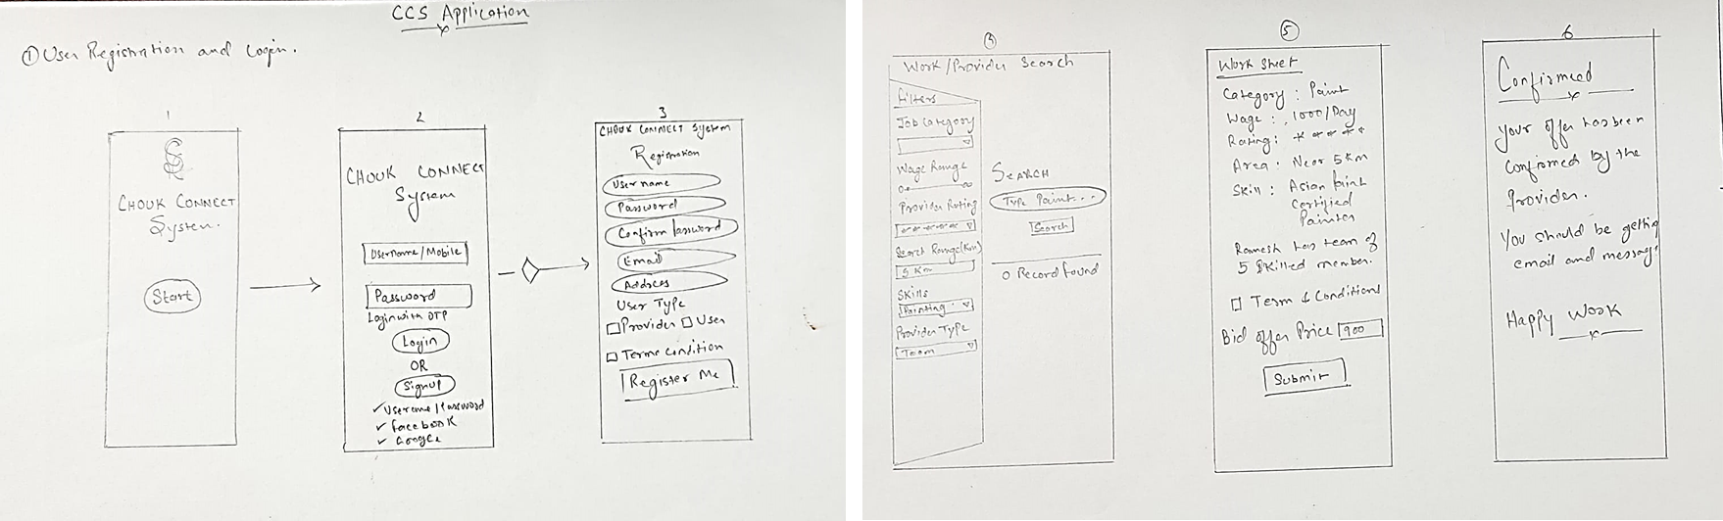
Low Fidelity Hand Drawn Sketch -
Anand Prakash Dubey (2022MT93359)

Slide 10
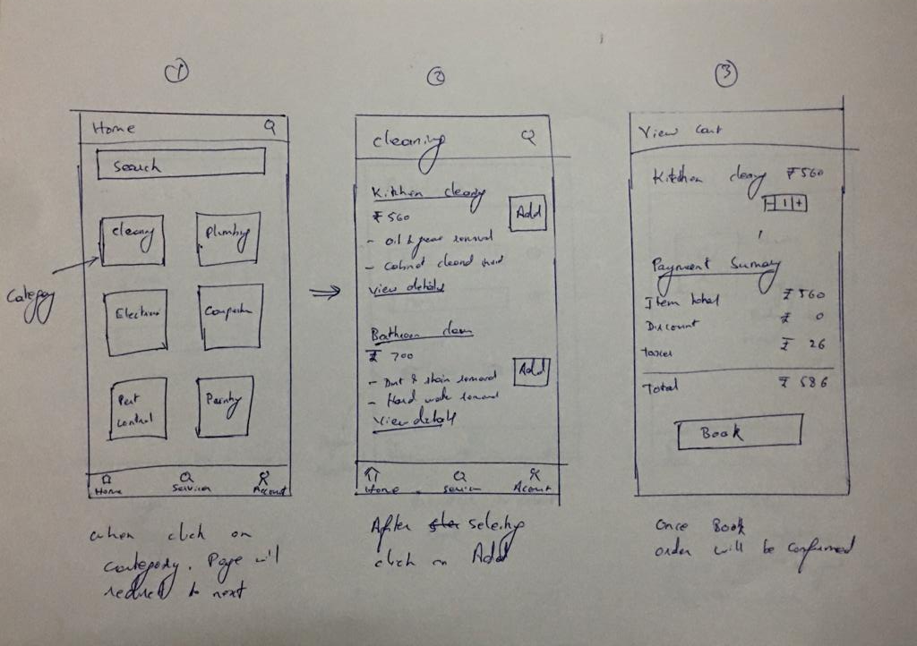
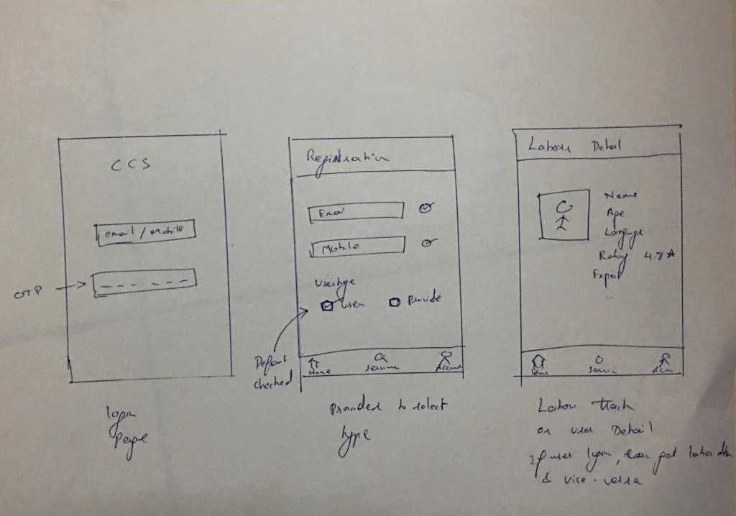
Low Fidelity Hand Drawn Sketch -
Amit Naik (2022MT93215)

Slide 11
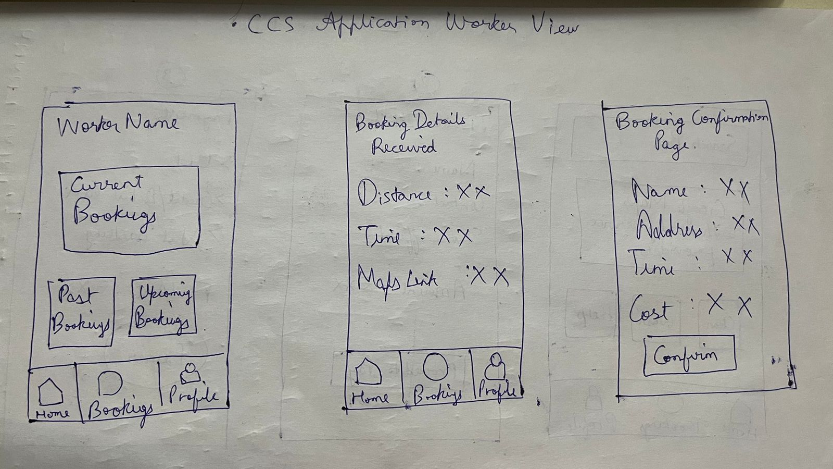
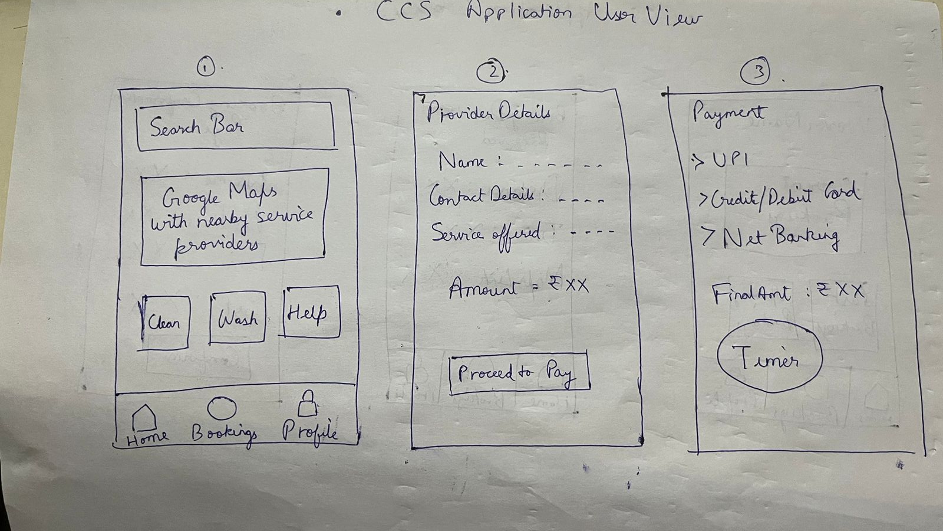
Low Fidelity Hand Drawn Sketch -
Anant Patni (2022MT93238)

Slide 12
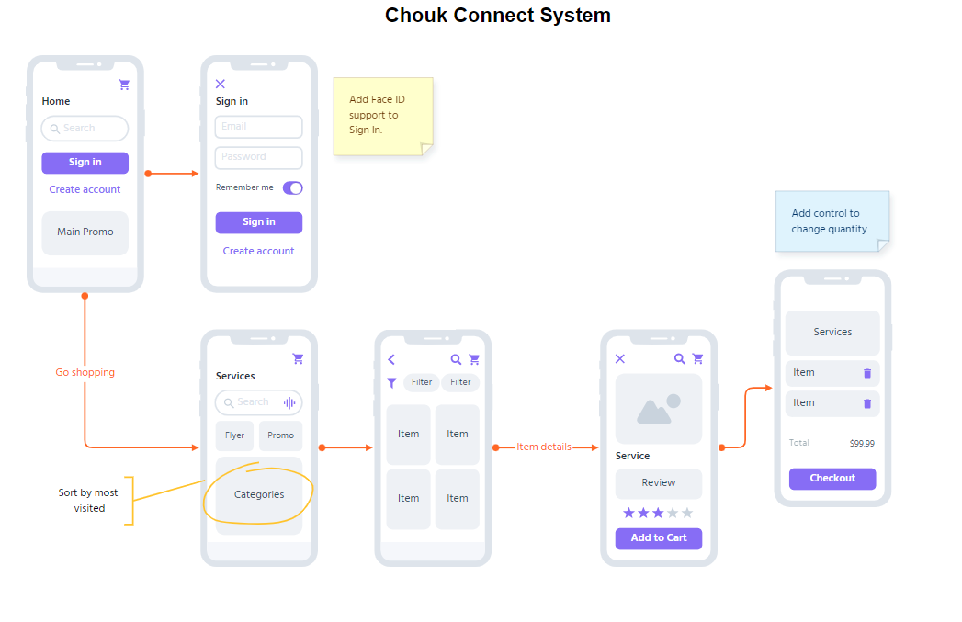
Wireframe storyboard for the best solution

Slide 13
Validate - Customer feedback
Ritu Jindal : "I love the convenience of using Chouk Connect to find reliable professionals for my home services. The app is easy to use and I appreciate the detailed profiles of each professional, which helps me make informed decisions."
Nishith : "The Chouk Connect app has made it so much easier for me to find and book appointments with trusted professionals. However, I would like to see more filters and search options to make it easier to find exactly what I'm looking for."
Sandesh : "I'm really impressed with the quality of professionals I've found through Chouk Connect. The app has saved me so much time and hassle, and I appreciate the transparent pricing and payment system."
Akshath : "While I like the concept of Chouk Connect, I find the app a bit overwhelming and cluttered. I wish there were more streamlined navigation and fewer pop-ups and ads."
Sneha : "I had a great experience using Chouk Connect to find a professional for my plumbing needs. The app was easy to use and the professional I hired was prompt, reliable, and skilled. I will definitely use this app again in the future."

Slide 14
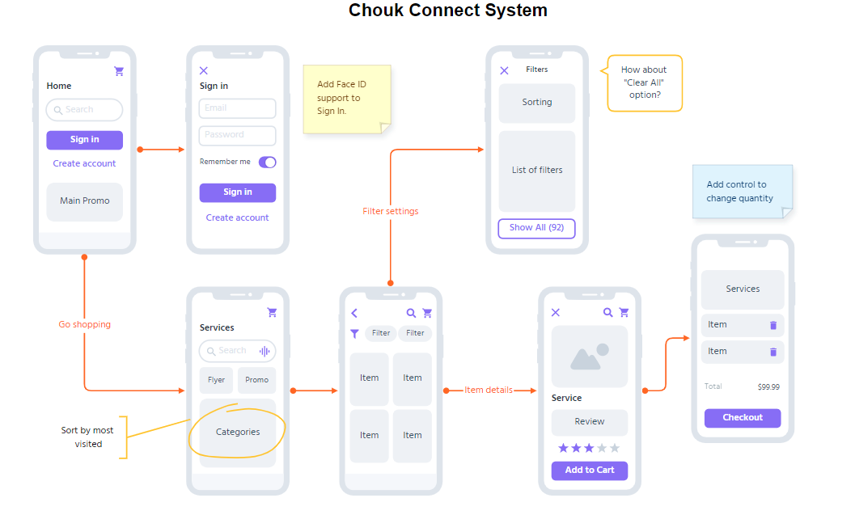
Iterate - Added filter screen based on customer feedback

Slide 15
Key learning -AMIT NAIK (2022MT93215)
We learnt about low fidelity wireframes, which is quick and easy way to visualize the layout and structure of a product, without getting bogged down in the details of design or functionality.
Customer in early stage is very important to get good quality of the product
By MVP feature, we got focus on core needs of the users for product.
Focus on MVP features that are most important to the user, add the most value, and require the least amount of effort to develop

Slide 16
Key learning -Anand Prakash Dubey (2022MT93359)
I gained knowledge about low fidelity wireframes, which offer a fast and effortless approach to depict the arrangement and framework of a product, without getting caught up in the intricacies of design or functionality.
Discovering the significance of receiving customer feedback during the initial phases of product development is crucial in delivering a Minimum Viable Product (MVP).
The significance of a wireframe storyboard lies in its ability to facilitate comprehension of the final product and its features.
The significance of obtaining customer feedback during the design phase of MVP and feature development cannot be overstated.

Slide 17
Key learning -ANANT PATNI (2022MT93238)
Learnt about how MVP features are defined.
Got to know about ideation in form of a low fidelity hand drawn sketch
Learnt about storyboarding in terms of selecting the best ideas from the wireframe
Finally got to know about how customer feedback and validation helps in completion

